Slide 1

Transaction concept and ACID properties
Database Management System | Transaction Management and Scheduling
Course: Database Management System | Chapter: Transaction Management and Scheduling | Program: B.TECH-CSE, B.TECH CSE - CYBER SECURITY, B.TECH CSE - DATA
DISCOVER · LEARN · EMPOWER
Notes:
Welcome everyone to today's session on Transaction Management. We will dive deep into the fundamental concept of a transaction and the four critical properties that ensure data integrity. Understanding these concepts is essential for analyzing how databases handle concurrent operations without losing data consistency.

Slide 2
Course Outcomes
SLIDE 2 / 14
Course Outcome
CO | BT LEVEL | DESCRIPTION
CO1 | BT2 | Explain database architecture, relational model concepts and formal query language foundations including relational algebra and relational calculus.
CO2 | BT3 | Apply relational algebra, relational calculus and SQL constructs to formulate correct and efficient database queries.
CO3 | BT4 | Analyze functional dependencies and design normalized relational schemas up to 5NF ensuring lossless join and dependency preservation.
CO4 | BT4 | Analyze transaction schedules and concurrency control mechanisms to determine serializability, recoverability and correctness.
CO5 | BT5 | Evaluate storage structures, indexing strategies and query optimization techniques for performance, scalability and reliability.
Chandigarh University
2 / 14
Notes:
Today's lecture directly addresses CO4 by teaching you how to analyze transaction schedules for correctness. We will also touch upon CO5 by understanding how transaction properties influence storage reliability and system performance during high-concurrency scenarios.

Slide 3
Learning Objectives
SLIDE 3 / 14
Learning Outcomes
1
Define a database transaction as a logical unit of work.
2
Analyze the four ACID properties ensuring data reliability.
3
Evaluate the impact of atomicity on partial updates.
4
Distinguish between serial and concurrent execution schedules.
5
Apply consistency rules to real-world banking scenarios.
Chandigarh University
3 / 14
Notes:
By the end of this session, you will be able to define a transaction and break down its four pillars. We will analyze why atomicity prevents partial updates and evaluate how consistency rules apply to complex banking transactions. These skills are crucial for designing robust database systems.

Slide 4
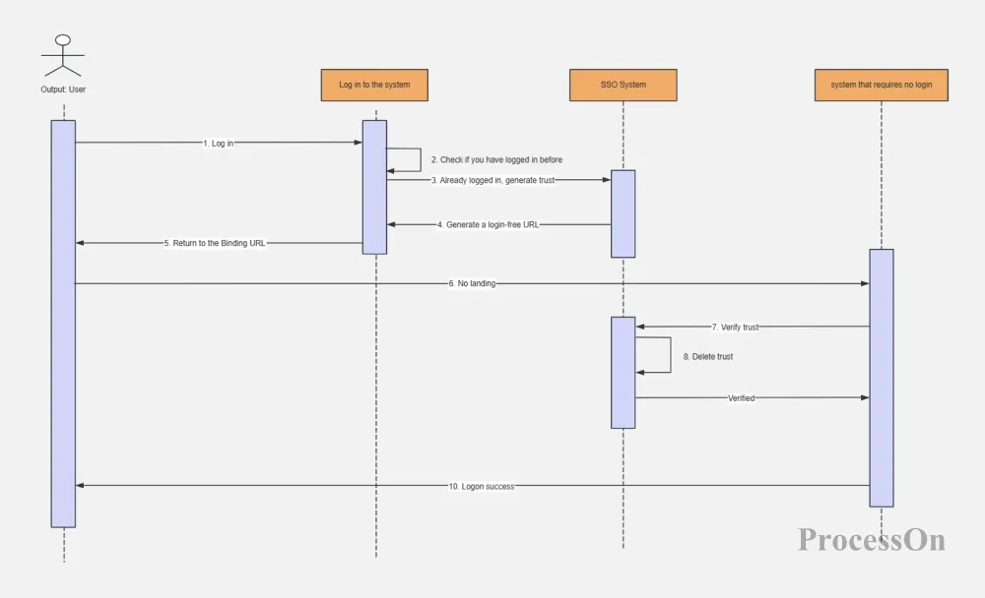
Lecture
SLIDE 4 / 14
Definition of a Transaction
1
A transaction is a logical unit of work comprising one or more operations.
2
It must transition the database from one consistent state to another.
3
Operations include reading data, writing data, or deleting records.
4
The transaction ends with either a commit or an abort action.
5
All operations within a transaction must succeed or fail together.
What is a UML sequence diagram? Attached tutorial and examples - ProcessOn
Chandigarh University
4 / 14
Notes:
Think of a transaction as a single, indivisible task. For example, transferring money involves reading the balance, deducting the amount, and updating the balance. If any step fails, the entire transaction must be rolled back to maintain the logical unit of work.

Slide 5
Lecture
SLIDE 5 / 14
Atomicity Property Explained
1
Atomicity ensures all operations succeed or none are applied.
2
It prevents partial updates that leave the database in an invalid state.
3
The system uses a log to record changes before committing.
4
If a crash occurs, the log allows the system to undo changes.
5
Atomicity guarantees that the database remains consistent after failure.
Chandigarh University
5 / 14
Notes:
Atomicity is the 'all-or-nothing' principle. Imagine a transfer where the money is deducted from Account A but the system crashes before adding it to Account B. Without atomicity, money disappears. The system uses logs to ensure this never happens.

Slide 6
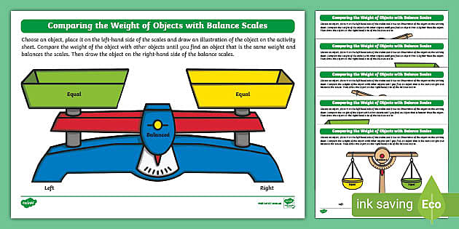
Lecture
SLIDE 6 / 14
Consistency Property Explained
1
Consistency ensures the database moves from one valid state to another.
2
All integrity constraints like foreign keys must remain valid after the transaction.
3
The sum of money in all accounts must remain constant after a transfer.
4
The DBMS enforces rules defined by the schema and application logic.
5
If a transaction violates a rule, it is aborted to preserve consistency.
Source: images.twinkl.co.uk
Chandigarh University
6 / 14
Notes:
Consistency is about maintaining the rules of the game. If you have a rule that total money must equal 1000, a transaction cannot change that total. The database checks these rules before and after every operation to ensure no constraints are violated.

Slide 7
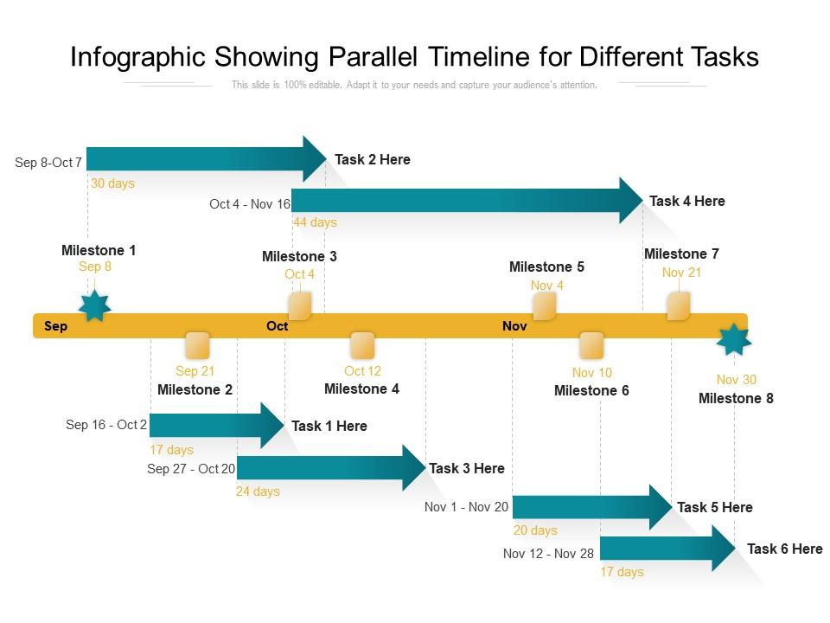
Lecture
SLIDE 7 / 14
Isolation Property Explained
1
Isolation ensures concurrent transactions do not interfere with each other.
2
Intermediate results of a transaction are invisible to other transactions.
3
It mimics serial execution even when transactions run simultaneously.
4
Without isolation, phenomena like dirty reads can corrupt data.
5
The isolation level determines the degree of concurrency allowed.
Source: www.slideteam.net
Chandigarh University
7 / 14
Notes:
Isolation is like having a private room for each transaction. Even if two people are transferring money at the exact same time, they should not see each other's unfinished work. This prevents errors where one transaction reads data that another is currently changing.

Slide 8

Lecture
SLIDE 8 / 14
Durability Property Explained
1
Durability guarantees that committed changes survive system failures.
2
Once a transaction commits, its data is permanently stored on disk.
3
The system writes changes to stable storage before confirming success.
4
Power loss or crashes cannot undo a committed transaction.
5
Recovery mechanisms restore the database state after a failure.
Source: static.vecteezy.com
Chandigarh University
8 / 14
Notes:
Durability is the promise that once you see 'Success', the data is safe forever. Even if the power goes out immediately after you commit a transfer, the database will restore that change upon restart. This is achieved by writing to stable storage before acknowledging the commit.

Slide 9
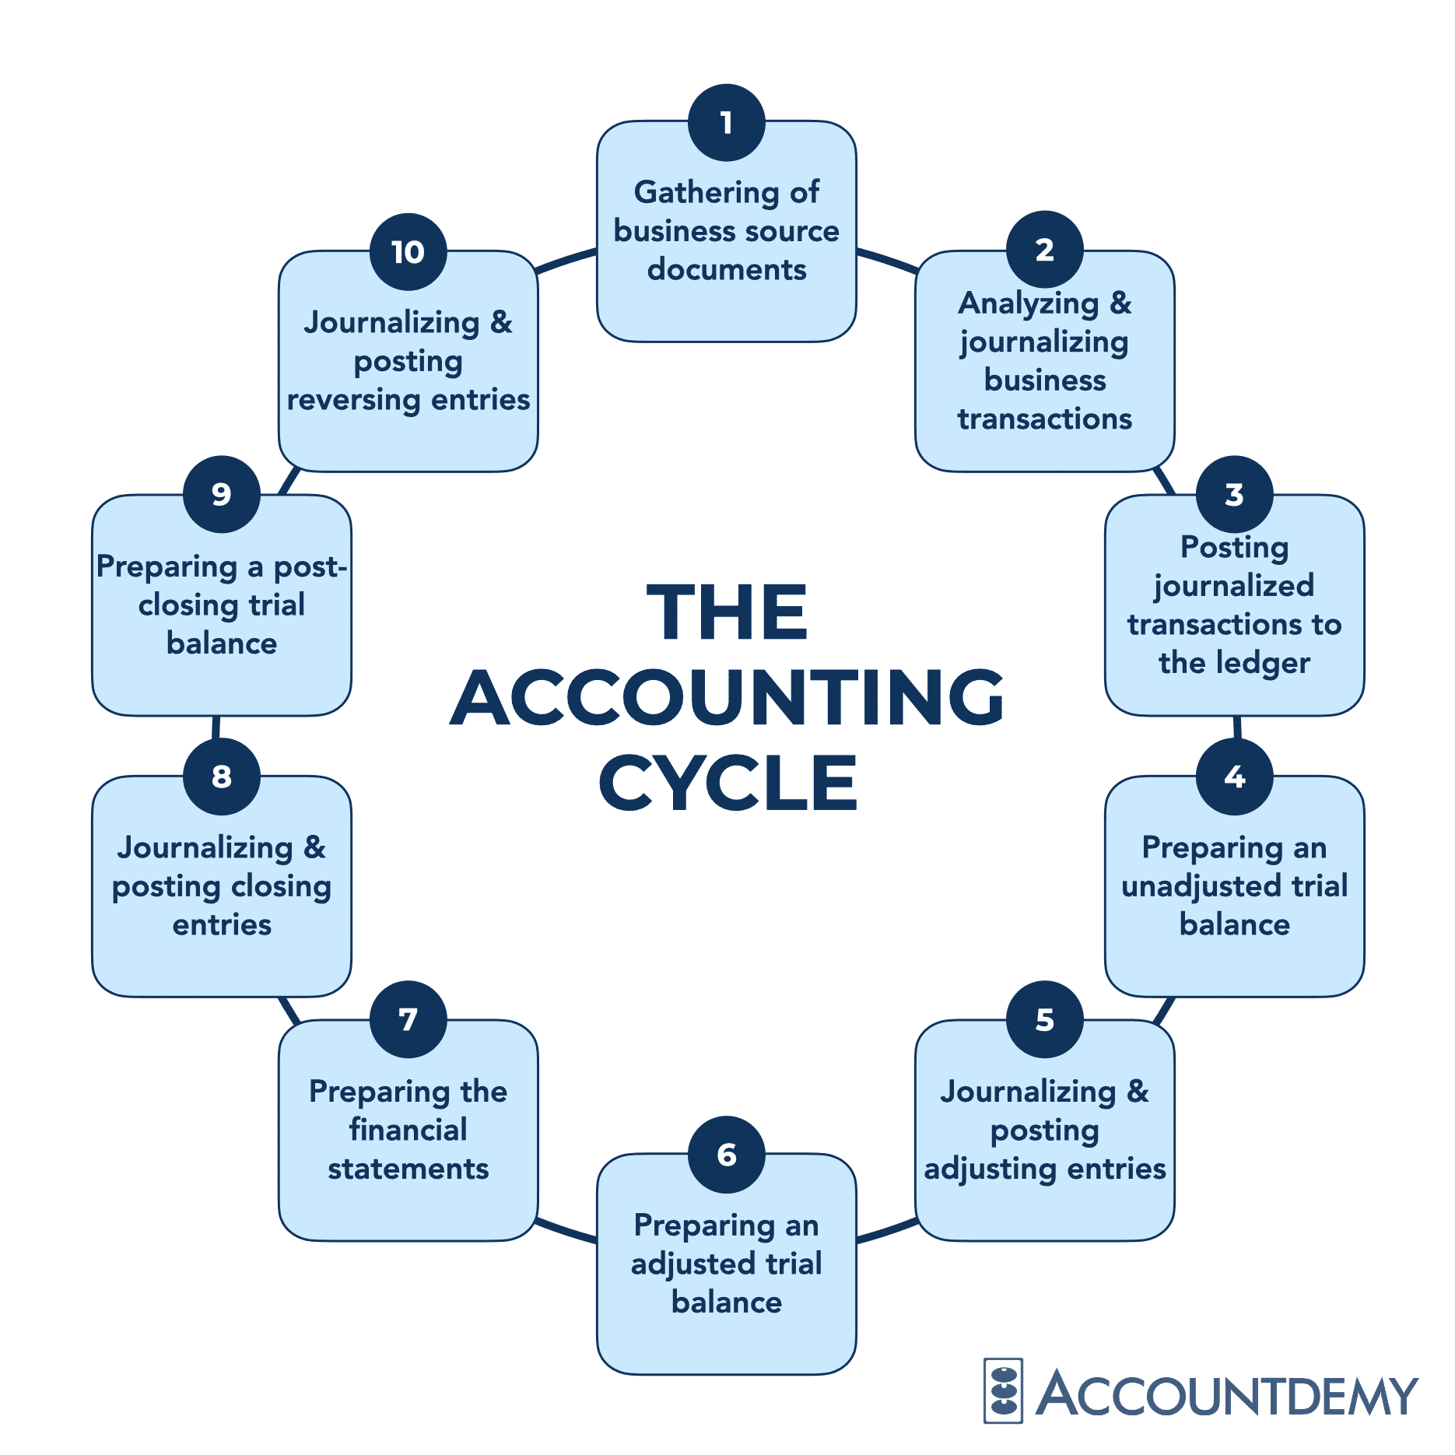
Worked Example
SLIDE 9 / 14
Money Transfer
SCENARIO
Transfer 500 from Account A (1000) to Account B (500).
STEP 1
Read A (1000), deduct 500, write A (500).
STEP 2
Read B (500), add 500, write B (1000).
TOTAL BEFORE
1500. Total after: 1500. Consistency maintained.
• If Step 2 fails, atomicity rolls back Step 1 to restore original state.
Source: accountdemy.com
Chandigarh University
9 / 14
Notes:
Let's calculate the numbers. We start with 1000 and 500, totaling 1500. After transferring 500, we have 500 and 1000, still totaling 1500. If the system crashes after the first step, atomicity ensures we revert to 1000 and 500, preserving the total sum.

Slide 10

Common Pitfalls
SLIDE 10 / 14
Dirty Reads
EXAMPLE
Reading a balance that is later cancelled by a rollback.
• A dirty read occurs when a transaction reads uncommitted data.
• If the writing transaction rolls back, the reading transaction has invalid data.
• This violates the isolation property and leads to incorrect calculations.
• Strict isolation levels prevent dirty reads by locking data during writes.
Source: static.vecteezy.com
Chandigarh University
10 / 14
Notes:
One major pitfall is the dirty read. Imagine reading a balance that is currently being updated by another user. If that user cancels the update, your read was based on garbage data. This is why isolation levels are critical for preventing such errors.

Slide 11
Common Pitfalls
SLIDE 11 / 14
Lost Updates
EXAMPLE
Two users update the same account balance simultaneously.
• A lost update happens when two transactions overwrite each other's changes.
• The second transaction overwrites the first without seeing its intermediate state.
• This results in the loss of valid data modifications.
• Locking mechanisms prevent lost updates by serializing conflicting operations.
Chandigarh University
11 / 14
Notes:
Another common issue is the lost update. If two people try to update the same account at the same time, the second update might overwrite the first one completely. This means the first person's change is lost forever, which is a serious consistency violation.

Slide 12
Common Pitfalls
SLIDE 12 / 14
Non-Repeatable Reads
EXAMPLE
Reading a salary, then another transaction updates it, then reading again.
• A non-repeatable read occurs when a row is read twice with different values.
• This happens if another transaction modifies or deletes the row in between.
• The first transaction sees inconsistent data within its own execution.
• Serializable isolation levels prevent this by locking rows for the duration.
Chandigarh University
12 / 14
Notes:
Consider a non-repeatable read where you read a salary, then someone else changes it, and you read it again. You get two different values for the same row in the same transaction. This breaks the expectation of consistency within a single logical unit of work.

Slide 13
Lecture
SLIDE 13 / 14
Key Takeaways
1
A transaction is a logical unit of work that must be atomic.
2
ACID properties ensure reliability, consistency, isolation, and durability.
3
Atomicity prevents partial updates during system failures.
4
Isolation prevents interference between concurrent transactions.
5
Durability guarantees committed data survives crashes permanently.
Chandigarh University
13 / 14
Notes:
To summarize, remember that a transaction is a single unit of work. The ACID properties are the pillars that keep your data safe. Atomicity handles failures, isolation handles concurrency, and durability handles crashes. Mastering these concepts is key to database reliability.

Slide 14
Lecture
SLIDE 14 / 14
References
1
Fundamentals of Database Systems — Ramez Elmasri & Shamkant B. Navathe
2
Database System Concepts — Silberschatz, Korth & Sudarshan
3
Database Management Systems — Raghu Ramakrishnan & Johannes Gehrke
4
Oracle/MySQL Documentation — Oracle
Chandigarh University
14 / 14
Notes:
For further reading, please refer to the standard textbooks by Elmasri, Silberschatz, and Ramakrishnan. These resources provide in-depth coverage of transaction management and scheduling. The Oracle documentation is also excellent for practical implementation details.

